Slide 1
COMP SCI 1103/2103 Algorithm Design & Data Structure More about Inheritance
School of Computer Science
Notes:
This PowerPoint has been created for you to customise for your course. It can be used for your first lecture with students and uploaded to your MyUni course.
When you have finished customising the slides save as a PowerPoint Show ( .PPS)
Show students where they can access this PowerPoint in the MyUni course.

Slide 2
Previously on ADDS
Class Hierarchies
Behavior Separation
How to build a good class hierarchy? Focus on the requirements
Inheritance
Build classes from other classes
Why do we need inheritance?
Benefits
The derived class and the base class have an IS-A relationship
We don’t actually inherit the constructors but we can (and should) use them in our own.

Slide 3

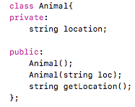

Example
Animal
Ape
Bird

Slide 4
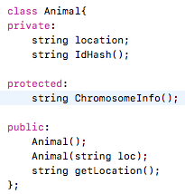
Access Specifiers
getLocation method in Animal is public -> All of its children can use it.
Animal may have private methods, e.g. idHash method that it uses for internal tracking -> Only Animal can access it.
What about something like Chromosome information?
Animal AND its children should be able to use it, but not anyone else
Protected

Slide 5
Access Specifiers
Private members can only be accessed from the inside of the class. (default for objects)
Public members can be accessed from any other classes.
A protected member (data field or function) in a base class can be accessed in its derived classes.
While, technically, we inherit almost everything from a parent, we can’t USE everything from the parent, unless it’s set up correctly.
Notes:
If the access specifier is omitted, the inheritance is private

Slide 6
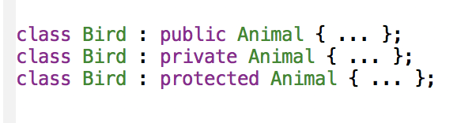
Access Specifier on Inheritance
Things that we inherit and use from a parent, are not necessarily visible from outside our class.
class Child : [access specifier] Parent { … };
Notes:
If the access specifier is omitted, the inheritance is private

Slide 7
Types of Inheritance (continue)
With public inheritance
Public members of parent become public members of child
Protected members of base become protected members of child
With protected inheritance
Public and protected members of parent become protected members of child
With private inheritance
Public and protected members of parent become private members of child
Quick Quiz
True or false?
Grand children always have access to protected members of grand parents.
False.

Slide 8
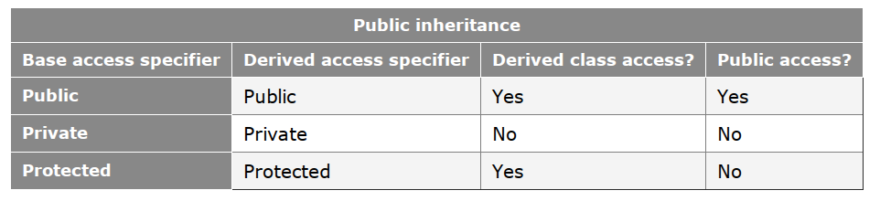
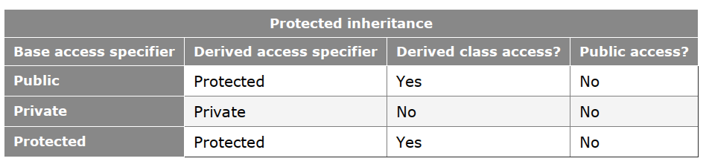
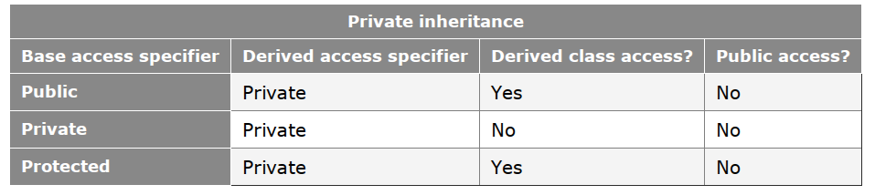
Types of Inheritance
What else can you guess?
Hint: protected inheritance vs private inheritance
Notes:
Protected and private inheritance serve different purposes from public inheritance.

Slide 9
Inheritance: some points
Regardless of access specifier:
The derived class inherits access to all public and protected members from the base class
The derived class has no access to the private members of the base class
The constructors and destructors of the base class are not members and therefore are not inherited
The assignment operator, while inherited, is hidden and can not be accessed.
The friend functions and classes of the base class are not inherited

Slide 10
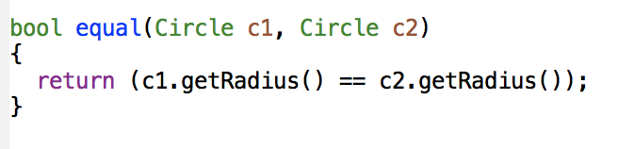
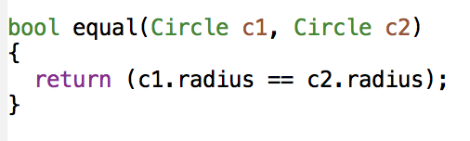
Motivation for friends
Suppose you want to compare two objects to see if they’re equal:
You could use the accessor methods to carry out comparison - what’s the problem with that?
You could access all of the member variables directly - what’s the potential problem with that?
Let’s say we want to define an external function that could still get access to the private members of a class.
Notes:
Getters for all fields
If this function is defined outside the class, it is not allowed

Slide 11
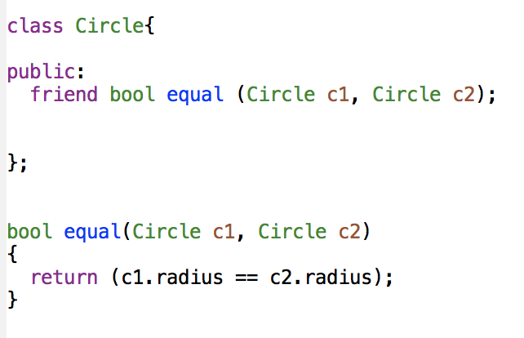
Friend
A friend function of a class has access to the private members of that class.
A friend function can directly read and change the value of a member variable.
Notes:
You make a function a friend of a class by listing the function declaration in the definition of the class and placing the keyword friend in front of the function declaration.
A friend is not a member function of the class.
You shouldn’t replace all of your accessors and mutators with friends - you may as well make everything public!

Slide 12
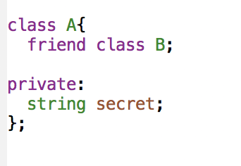
Friend Class
You can also have a friend class.
B has access to secret.

Slide 13
Friend
Friendship isn’t reciprocal.
Friendship isn’t transitive.
Friendship isn’t inherited.
You should use members when you can and friends when you have to.
The choice is based on design, syntactic suitability, and when it’s much harder to do it the other way.

Slide 14
Overloading
Overloading lets us reuse the same name but for different situations.
Functions have the same name but different parameter.
Overloading functions can make programs clearer and more readable.
Based on different return types?
No. Overloaded functions must have different parameter lists
Notes:
Ambiguous invocation: there are two or more possible matches for an invocation of a function. Compilation error

Slide 15
Overloading Operators
This isn’t just limited to functions.
We can overload operators (+,-,<<,>>) as well.
Operators That Can Be Overloaded
+ | - | * | / | % | ^ | & | |
~ | ! | = | < | > | += | -= | *=
/= | %= | ^= | &= | |= | << | >> | >>=
<<= | == | != | <= | >= | && | || | ++
-- | ->* | , | -> | [] | () | new | delete
Operators That Can Not Be Overloaded
?: | . | .* | ::
Notes:
Instead of being forced to write x = o.function() + p.function(), we could write x = o+p. Makes things more obvious, keeps control, can be part of a good design.
The operators are really functions, but with slightly different syntax.

Slide 16
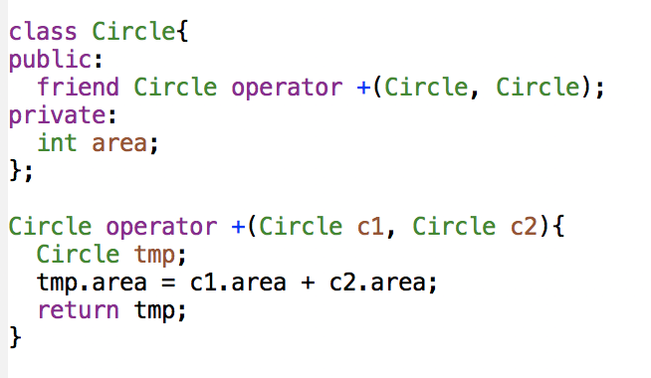
Friends and operators
If we overload an operator, we want to mimic the existing operator behavior, but using one of our classes.
Notes:
In order to overload operators, we need the keyword before the “function name”
1.When overloading an operator, at least one argument must be of a class type
2.Friend 3. cannot create 4. cannot change the # of operands
5. Cannot change the precedence

Slide 17
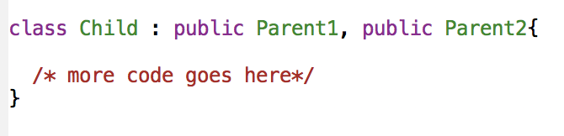
Multiple Inheritance
When something inherits behavior from two (or more) different objects!
Deriving directly from more than one class is called multiple inheritance.
How does this look like?
What are the possible problems?
Notes:
Go to the class for questions and try to get them sketching some ideas, graphically, given that we’ve worked graphically so far. Possible problems include multiply inheriting the same base class more than once (indirectly). This leads to ambiguity. Say you have a base class L, B1 inherits L, B2 inherits L, D inherits B1 and B2. You have to use qualified class names (next slides) to address this problem.
DON’T SPELL THIS OUT! We’re going to go through this in the next few slides - go and have a look to get some context.

Slide 18
Multiple Inheritance
The child gets all of the parents’ behaviors.
The order of derivation matters only for the order of default initialization and cleanup by constructors and destructors.
What happens if you derive from one class more than once? I mean indirectly!

Slide 19
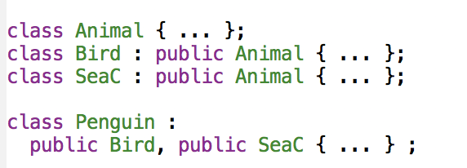
Example
This will compile.
But we have ambiguity. Why?
We have to refer to Bird::Animal or SeaC::Animal.
This is called a qualified class name.

Slide 20
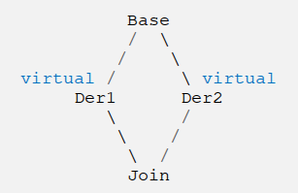
Using virtual
Referring to the same base class through different inheritance pathways is ambiguous if we are referring to two different versions of the base class.
Using virtual in the declaration of inheritance means that the grand child inherit only one subobject of the base class.
Problem solved by using virtual
Notes:
Dreaded Diamond. The so-called diamond of death has to be indirect.

Slide 21
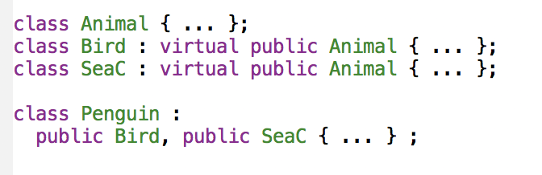
Example
This will compile.
We no longer have ambiguity because all references to Animal in Penguin go to the same class.
Look carefully at where we use virtual to control this.
Notes:
That’s where we need to make a decision.

Slide 22
Multiple Inheritance
It’s possible to mix up the use of virtual and have some derived classes sharing a base class and some not.
Always make sure you understand why you are using a keyword!

Slide 23
Summary
Inheritance is a very useful technique but you need to know how to use it effectively.
Behaviors are inherited.
Access modifiers.
When should I overload?
Multiple inheritance
We’ll talk about this more in Polymorphism.
When should I redefine/override?

Slide 24
Notes:
Save as a PowerPoint Show and upload to your MyUni course.
Before you upload the PPS customise slides and indicate where students will find them.

